Slide 1
20XD24 - OBJECT ORIENTED PROGRAMMING

Slide 2
Outline
Constructors and its types
Destructors
Pointers to class members

Slide 3
Constructors
A constructor is a special member function that must be defined with the same name as the class, so that the compiler can distinguish it from the class’s other member functions
An important difference between constructors and other functions is that constructors cannot return values, so they cannot specify a return type (not even void)
Normally, constructors are declared public
The constructor is invoked whenever an object of its associated class is created
A constructor is called whenever an object is defined or dynamically allocated using the “new” operator.
They are normally used to allocate memory for the data members and initialize them.
If no constructor is explicitly written then a default is created by the compiler (not in the case of const and reference data members)

Slide 4
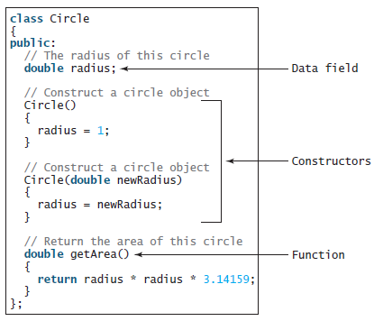
Constructors
The constructor call occurs implicitly when the object is created. If a class does not explicitly include a constructor, the compiler provides a default constructor—that is, a constructor with no parameters

Slide 5
Defining a Constructor
Constructors are a special kind of function, with three peculiarities:
Constructors must have the same name as the class itself.
Constructors do not have a return type—not even void.
Constructors are invoked when an object is created. Constructors play the role of initializing objects
Like regular functions, constructors can be overloaded (i.e., multiple constructors with the same name but different signatures), making it easy to construct objects with different sets of data values
It is a common mistake to put the void keyword in front of a constructor
For example,
void Circle()
{
}
Most C++ compilers will report an error, but some will treat this as a regular function, not as a constructor

Slide 6


Defining a Constructor
A class normally provides a constructor without arguments (e.g., Circle()) - called a no-argument constructor
A class may be defined without constructors. In this case, a no-arg constructor with an empty body is implicitly defined in the class.-called a default constructor, it is provided automatically only if no constructors are explicitly defined in the class
Data fields may be initialized in the constructor using an initializer list in the following syntax:

Slide 7
Types of Constructors
Default Constructor
Parameterized Constructor
Overloaded Constructor
Constructor with Default Arguments
Dynamic Constructor
Copy Constructor

Slide 8

Default Constructor
Two Ways to Provide a Default Constructor for a Class
Any constructor that takes no arguments - called a default constructor
A class can get a default constructor in one of two ways:
1. The compiler implicitly creates a default constructor in a class that does not define a constructor. Such a constructor does not initialize the class’s data members, but does call the default constructor for each data member that’s an object of another class. An uninitialized variable typically contains a “garbage” value
2. We can explicitly define a constructor that takes no arguments. Such a default constructor will call the default constructor for each data member that’s an object of another class and will perform additional initialization specified by us
Note: If you define a constructor with arguments, C++ will not implicitly create a default constructor for that class

Slide 9
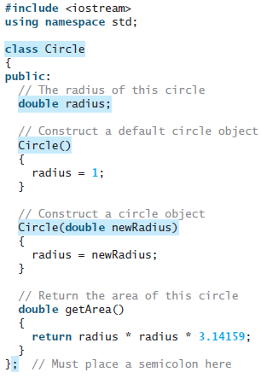
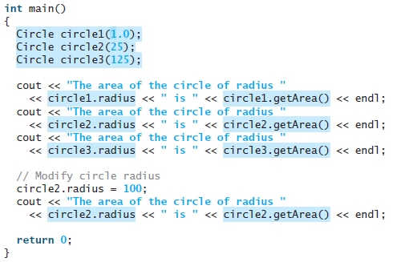
Constructors

Slide 10
Parameterized Constructor
Parameters can be passed to the constructors
class sum
{
public:
int x, y;
sum(int i,int j);
};
sum::sum(int i,int j)
{
x=i;y=j;
}
void main( )
{
sum s1(10,20);
sum s2 = sum(30,40);
cout<<"x= " << s1.x<<"y= "<<s1.y;
cout<<"x= " << s2.x<<"y= "<<s2.y;
}
Parameterized Constructor
Constructor called implicitly
Explicit call
x= 10 y= 20
Object s1
Object s2
x= 30 y= 40

Slide 11
Overloaded Constructors
Overloaded Constructors - Multiple constructors declared in a class
All constructors have different number of arguments
Depending on the number of arguments, compiler executes corresponding constructor
sum( ) {x=10;y=20;};
sum (int i, int j) {x=i; y=j;};
No arguments
Two arguments

Slide 12
Constructors with Default Arguments
Constructors can be defined with default arguments
class sum
{
int x, y;
public:
void print()
{ cout<<“x = “<<x<<“y =“<<y; }
sum(int i, int j=10);
};
sum::sum(int i,int j)
{ x=i;y=j; }
void main()
{ sum s1(1),s2(8,9);
s1.print();
s2.print();
}
Default value for j=10 (Used by the object s1)
Object s1
x= 1 y= 10
Object s2
x= 8 y= 9

Slide 13
Dynamic Constructor
Allocates the right amount of memory during execution for each object when the object’s data member size is not the same using new operator in the constructor
The allocated memory should be released when the object is no longer needed by delete operator in the destructor
#include<string.h>
class String
{ char* data;
public:
String(const char* s = "")
{ data = new char[strlen(s) +1];
strcpy(data,s);
}
~String( )
{ delete [ ] data; }
void display()
{ cout << data; }
};
main()
{
String s = "hello";
cout <<”s=”;
s.display( );
String s1(“hello world”);
cout<<”s1= ”;
s1.display();
}
s = hello
s1=hello world

Slide 14
Copy Constructor
Constructor that takes a reference to an object of the same class as argument is Copy constructor. C++ calls a copy constructor (deep copy or member-wise copy) to make a copy of an object.
Copy constructor is invoked in any of the following ways.
When one object explicitly initializes another
sum s3=s1;
When a copy of an object is made to be passed to a function
show(s2);
Returning an object by value from a function
s3=fun();
When a temporary object is generated
If there is no copy constructor defined for the class, C++ uses the default copy constructor which copies each data member, ie, makes a shallow copy or bit-wise copy

Slide 15
Copy Constructor
Syntax
class_name(class_name &object_name) //by reference is a must
{…}
class sum
{
public:
int x;
sum( ){ }
sum(int i) {x=i;}
sum(sum &j) {x=j.x;}
};
main( )
{ sum s1(10);
sum s2(s1);
sum s3=s1;
cout<<"\nx in s1= " << s1.x;
cout<<"\nx in s2= " << s2.x;
cout<<"\nx in s3= " << s3.x;
}
Objects
s1
s2
s3
x=10
x=10
x=10

Slide 16
Copy Constructor – Shallow Copy
Shallow Copy
copies the address
of s.data to t .data
#include<string.h>
class String
{ char* data;
public:
String(const char* s = "")
{ data = new char[20];
strcpy(data,s);
}
~String( )
{ delete [ ] data; }
void assign(char *str)
{ strcpy(data,str); }
void display()
{ cout << data; }
};
void main()
{ String s = "hello";
String t = s; // same as String t(s);
s.display( );
t.display( );
t.assign(“world”);
s.display( );
t.display( );
}
hello
hello
world
world
data
s
hello\0
t
data
data
s
world\0
t
data

Slide 17
Copy Constructor – Deep Copy
String(const String& s)
{
data = new char[strlen(s.data)+1];
strcpy(data, s.data);
}
Deep Copy copies the value of the object s to t
data
hello\0
s
Deep copy
data
t
hello\0

Slide 18
Constructor with initialization list
Initialization of data members can also be done using initialization list.
Syntax: class_name(arg_list) : InitializationSection
{ }
Example
For references and const data members constructor with initialization list is a must (no default constructor is provided)
class A
{
int a;
int b;
public:
A(int x):a(x),b(2*x){ }
void print( ){ cout<<a<<b; }
};
main( )
{
A object1(10);
object1.print()
}

Slide 19
Destructors
A destructor is a member function that is automatically called when an object is destroyed
Destructors are member functions with the same name as the class, preceded by a tilde character (~)
For example, the destructor for the Rectangle class would be named ~Rectangle
Destructors are automatically called when an object is destroyed
In the same way that constructors set things up when an object is created, destructors perform shutdown procedures when the object goes out of existence
For example, a common use of destructors is to free memory that was dynamically allocated by the class object

Slide 20
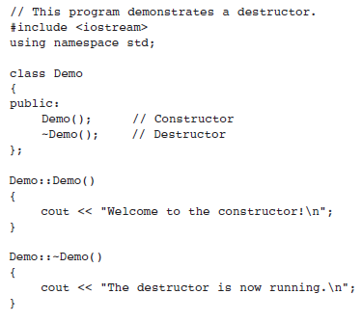
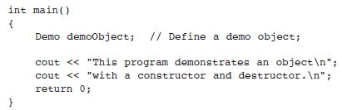

Destructors

Slide 21
Destructors
In addition to the fact that destructors are automatically called when an object is destroyed, the following points should be mentioned:
Like constructors, destructors have no return type
Destructors cannot accept arguments, so they never have a parameter list
Because destructors take no arguments, the compiler has no way to distinguish different destructors
A destructor takes no arguments and has no return type
Its address cannot be taken
Destructors cannot be declared const, volatile, const olatile or static. A destructor can be declared virtual
If no user-defined destructor exists for a class and one is needed, the compiler implicitly declares a destructor. This implicitly declared destructor is an inline public member of its class

Slide 22
Destructors
Destructors are called when one of the following events occurs:
A local (automatic) object with block scope goes out of scope
An object allocated using the new operator is explicitly deallocated using delete
The lifetime of a temporary object ends
A program ends and global or static objects exist
There are two restrictions on the use of destructors
You cannot take its address
Derived classes do not inherit the destructor of their base class
Destructors for nonstatic member objects are called in the reverse order in which they appear in the class declaration

Slide 23
Pointers to Class members and Objects
Defining a Pointer of Class type
We can define pointer of class type. It can be used to point to class objects
Class_name* ptr;
ptr= &obj;
(or)
Class_name* ptr= new Class_name();
Access the members with ‘→’ operator

Slide 24
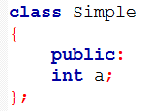
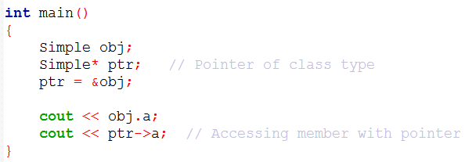
Pointers to Class members and Objects
Defining a Pointer of Class type

Slide 25
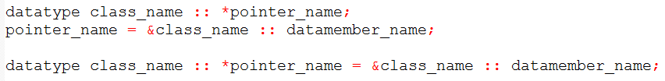
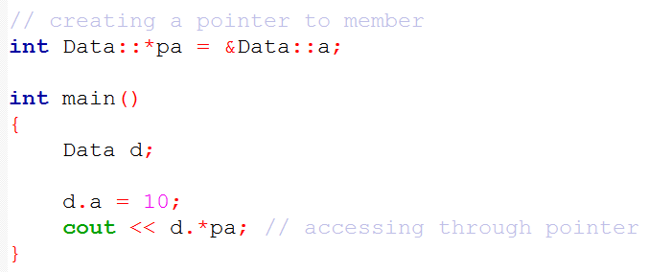
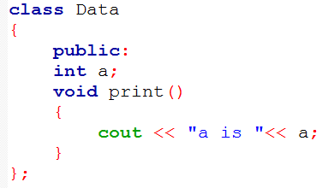
Pointers to Class members and Objects
Pointer to Data Members of Class
We can use pointer to point to class's data members (Member variables)

Slide 26
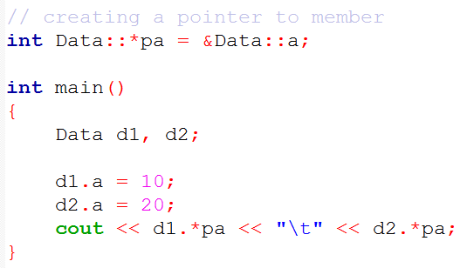
Pointers to Class members and Objects
Pointer to Data Members of Class

Slide 27
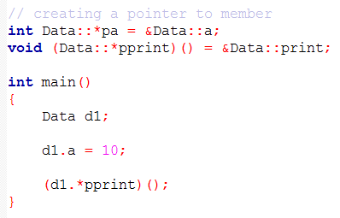
Pointers to Class members and Objects
Pointer to Function Members of Class

Slide 28

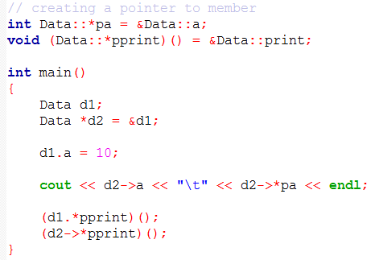
Pointers to Class members and Objects
Using Pointers with Objects

